Slide 1
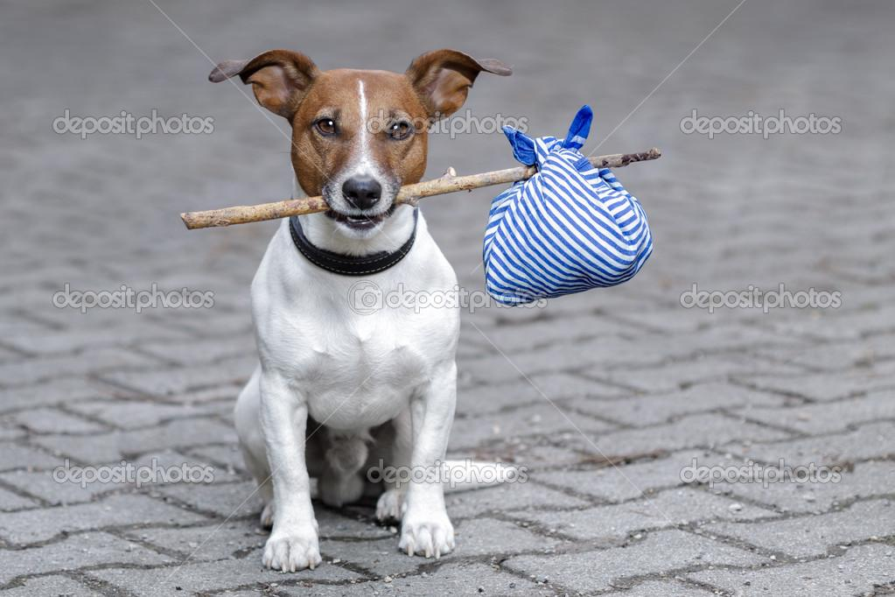
2022 RTO Hackathon:
QR Reunite
by
Pet-TECH Masters
July 24, 2022

Slide 2





The “Hoomans” behind QR Reunite
We are students from different parts of the United States. We are united by our passion for Computer science, and love for animals.
Hongrui Liu
He/Him
UMich
Sijia Li
She/Her
UMich
Lingrui Li
She/Her
Stevens Inst.
Ezhil Nikhilan C
He/Him
Rutgers
Valenteana Fung
She/Her
UIC

Slide 3
The Achilles Heel: Mutual aid & Community involvement
The existing resources for pet rescue and RTO rely on a ‘passive’ style of searching. Below are some of the problems with the traditional methods that motivated us to pursue this proposal:
It requires considerable effort and sometimes even luck to make sure that a “lost” or “found” post reaches the community wide enough to make an impact. Pets can be misidentified.
According to the RTO_Hackathon data, approximately 65% of the found pets were found within 1 mile of the lost location. This shows that involving the local community can potentially be very effective and fast. Additional resources
Existing devices like GPS trackers, or microchips are either invasive, prohibitively expensive, or require considerable technological acumen.
Awareness regarding safe practices, and resources is either too little or too late.
People who find the pet eventually are deterred from helping due to cumbersome processes, or general apathy.
We propose a simple QR-Code based method for identifying pets, and sending automated notifications to the pet owners and the pet-owners community for enabling a quicker response.
Notes:
KEVIN

Slide 4


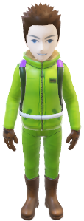


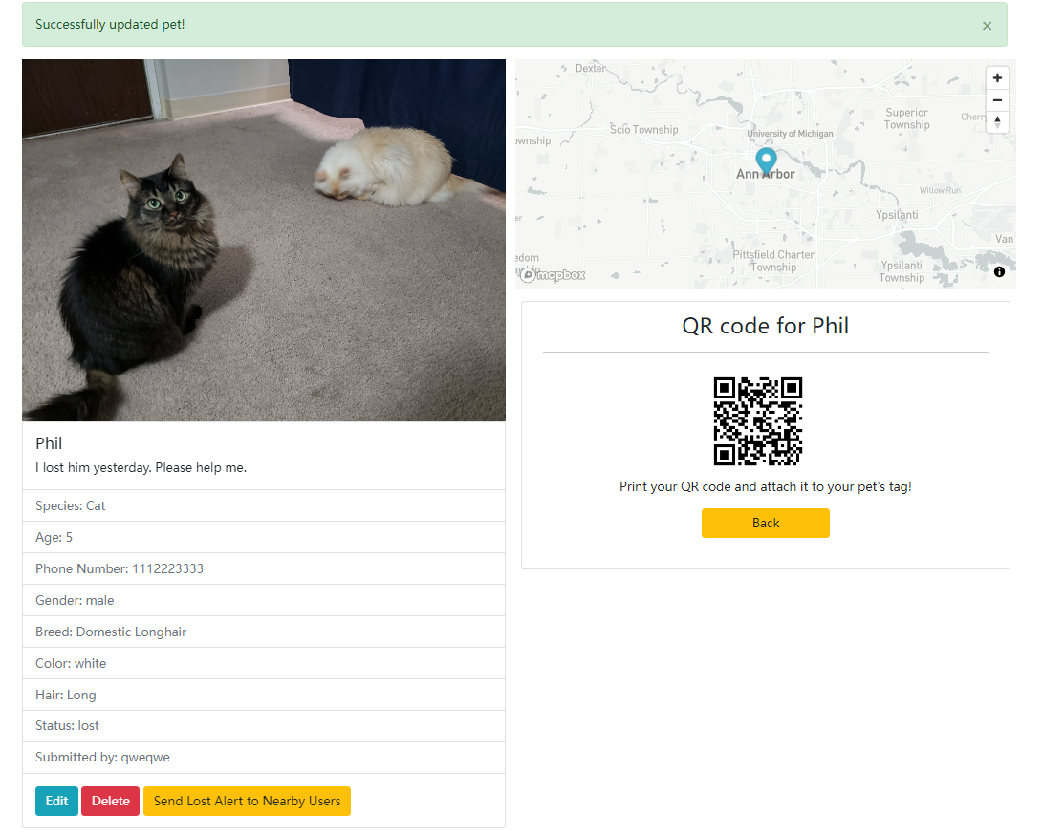
Stakeholders: It’s You and Me.
Our product aims to connect the first level responders directly to the owner.
Intended users:
Pet Owners: Can register their pets, report lost/stolen, and send/receive notifications about lost pets.
Pet rescuers: Can be passersby or pet rescue volunteers who make first contact with the lost pet.
Community: A network of registered owners in the locality.
User 1: Owner
User 2: Finder/
Volunteer

Slide 5
QR Reunite: United we stand, Divided we find.
Rescuer
Our proposed solution aims to simplify and expedite the Return to Owner process.
Pet owners can register/edit their pet/contact details and generate a QR code based on the latest information.
This can be attached on the pet collars/tags for the rescuers to scan.
Once a pet is lost, all the owners in the nearby locations automatically receive a notification about the lost pet. All owners can access the lost pet details on our website.
Any rescuer can scan the QR code to reach the pet details page from where, they can trigger an email to the owner with a custom message. The pet’s location can also be shared with this notification.
Tech Stack Used: Node.js, Express.js, EJS Templates, MongoDB, Mapbox API, Passport.js
Scans QR Code. No need to login
Can access Owner/Pet info; Trigger Email notification to the owner
Owner
Registers pet /Generates QR Code
Can Login, Report pet as lost, Trigger email notifications, and access nearby lost pet info.
Community
Expedites the search – Owners act as rescuers.
Same as Owner/Rescuer

Slide 6
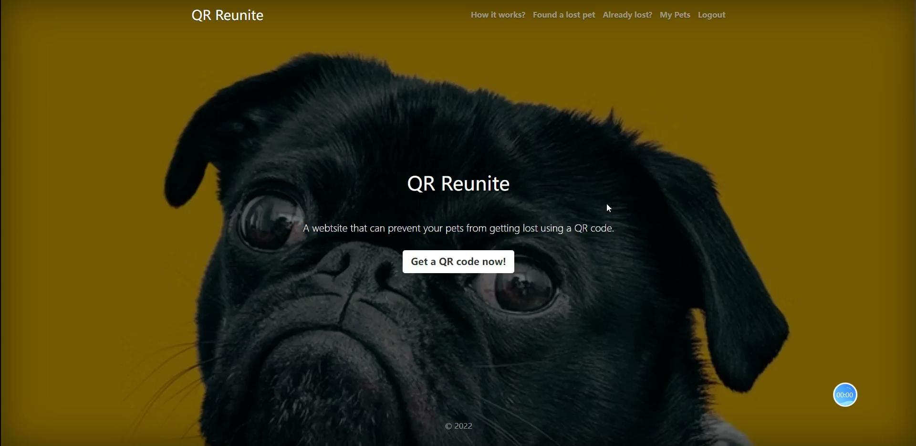
Demo: Not the everyday pet rescue story.

Slide 7
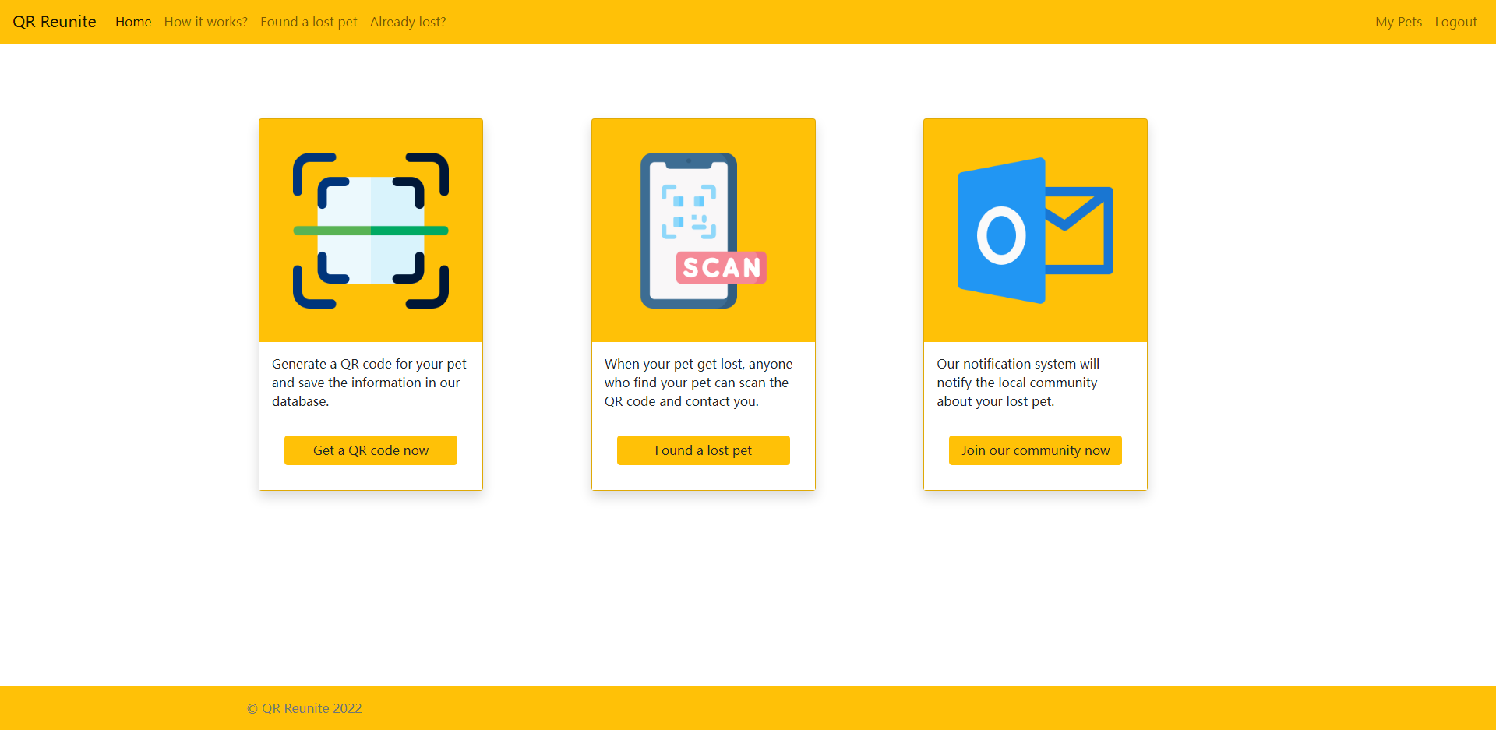
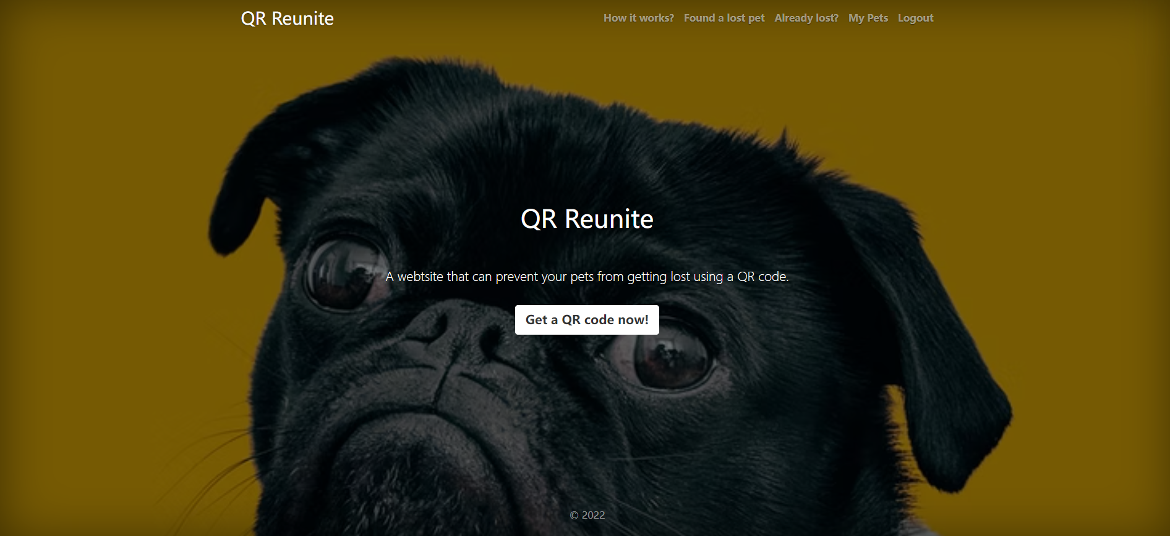
Demo

Slide 8
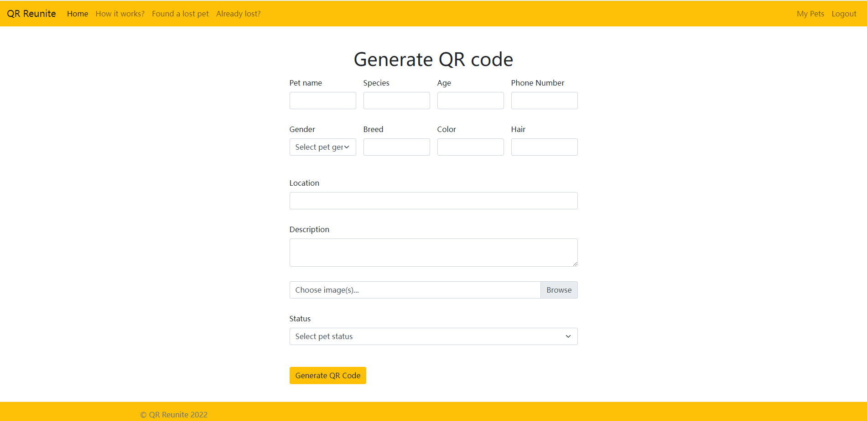
Demo

Slide 9
Demo

Slide 10
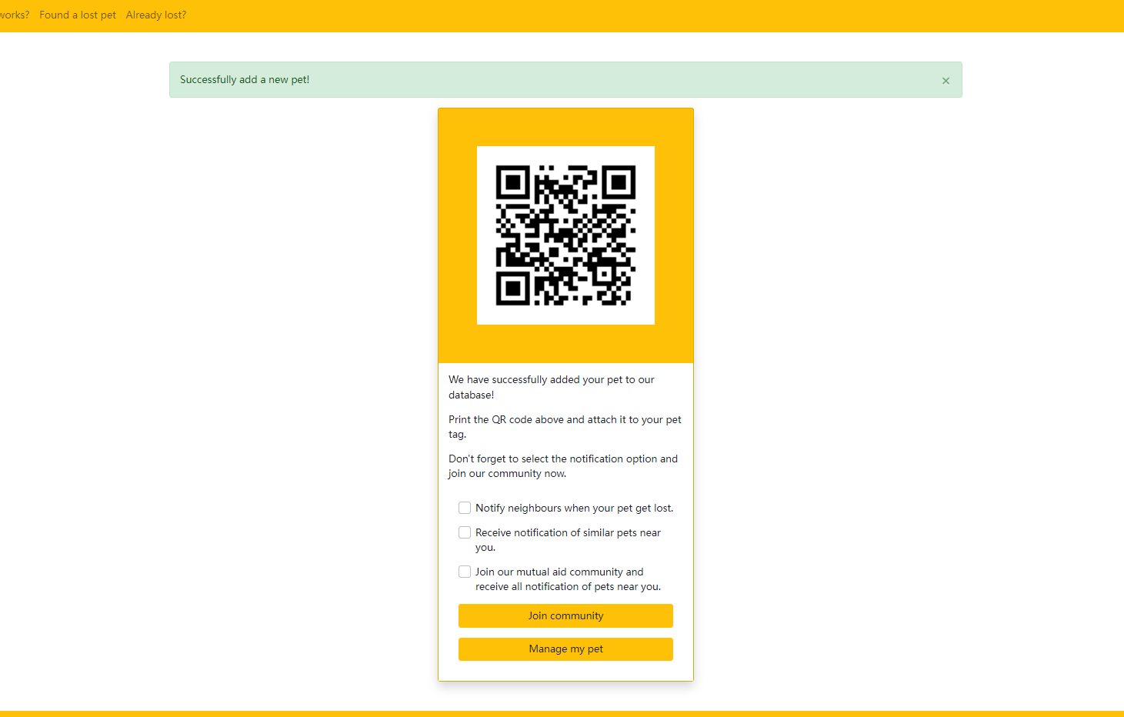
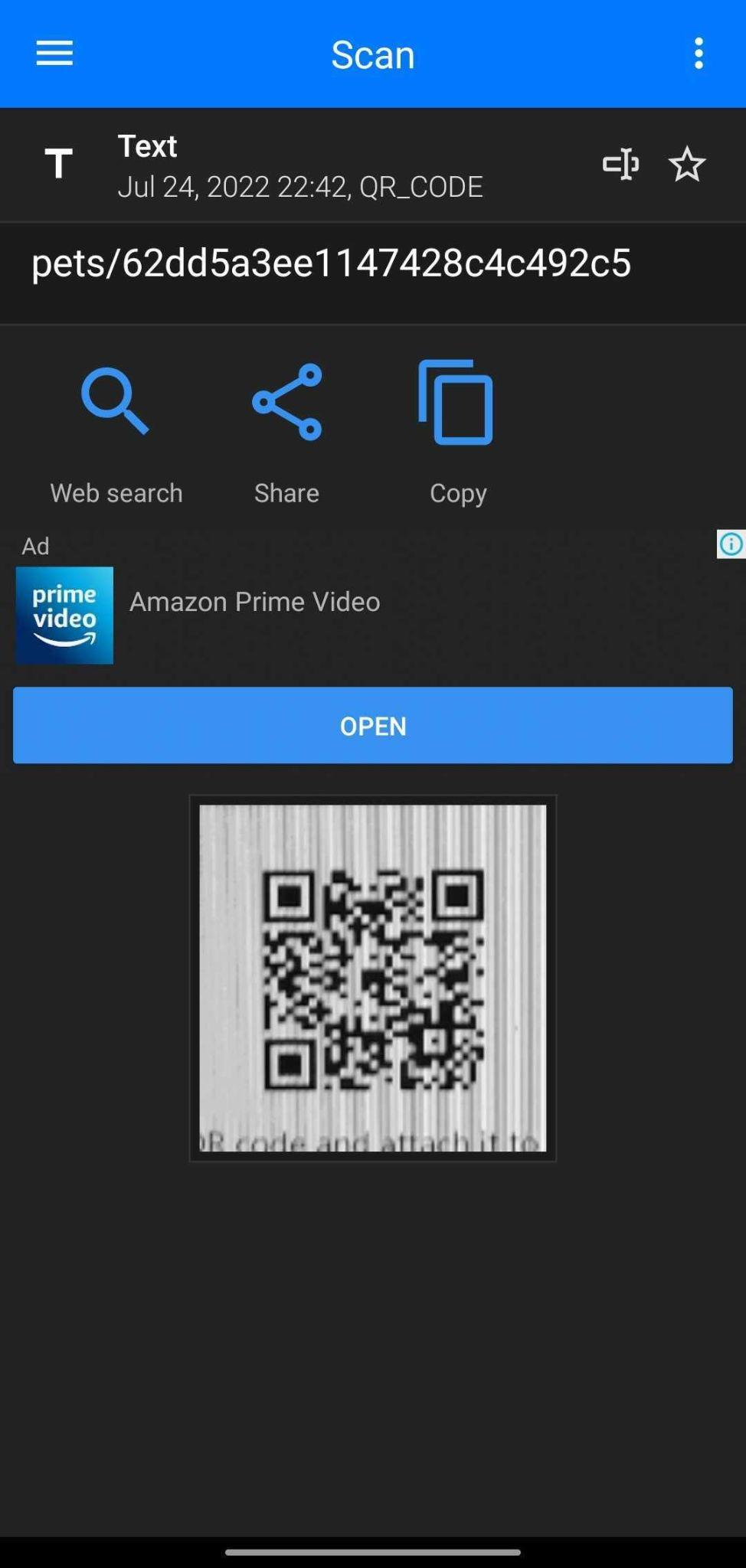
Demo

Slide 11
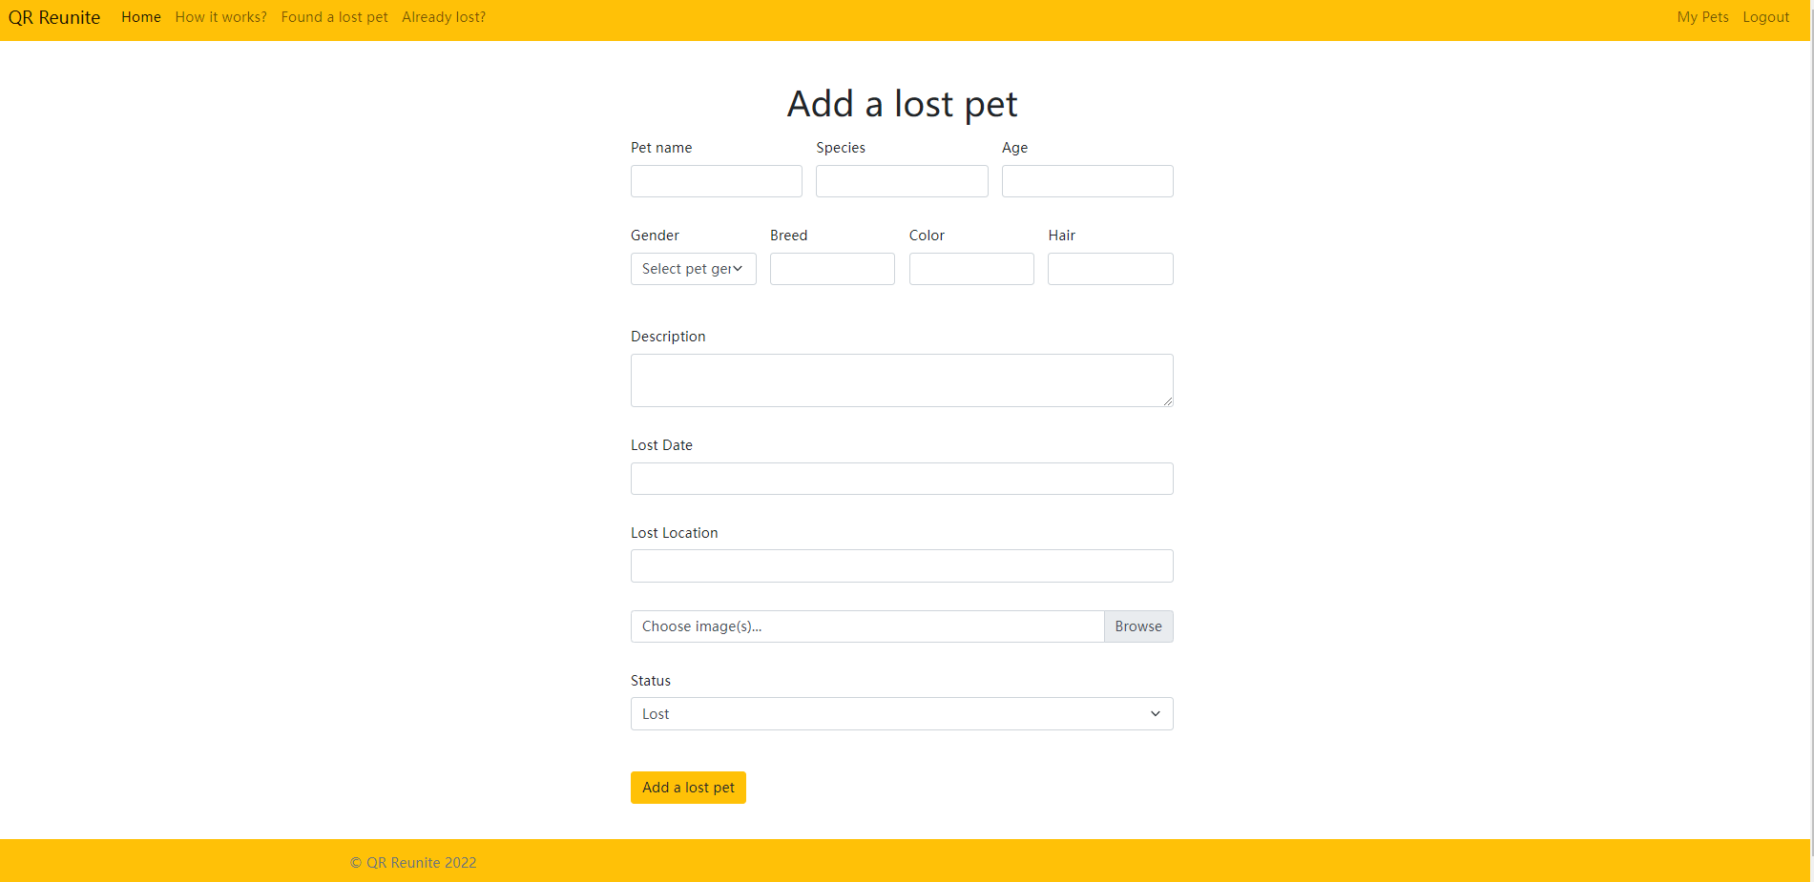
Demo

Slide 12
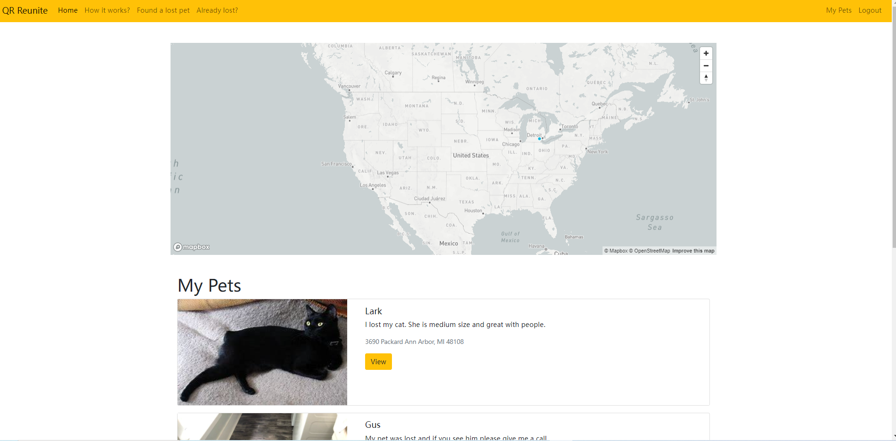
Demo

Slide 13
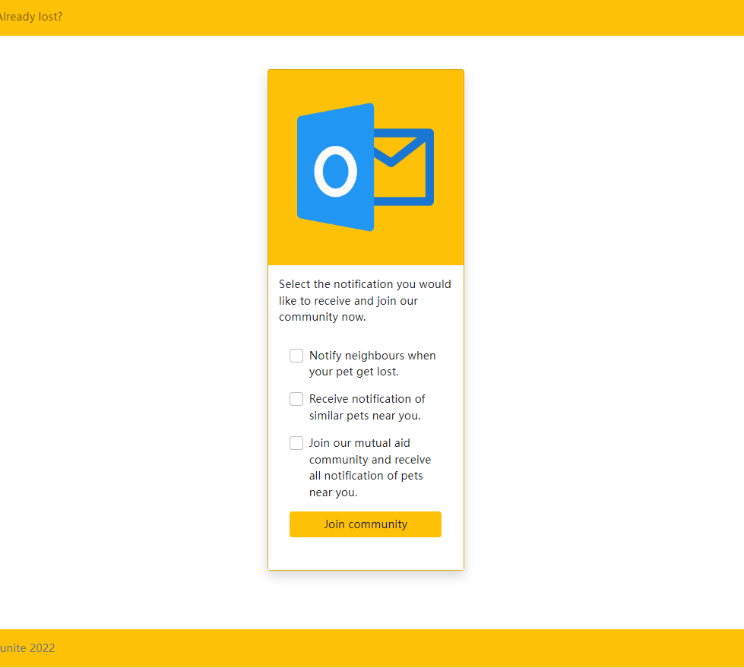
Demo

Slide 14
Why all the ‘Good Bois’ in the neighborhood will love this…
Feature | Problems addressed
QR Code Tags | Dynamic information vs Outdated/limited information on physical collars. Any passerby can scan without restraining the animal Ease of use. Only a mobile phone is sufficient vs complicated equipment for microchip scanning
Owner notifications | The rescuer can immediately and effortlessly notify the owner without concerns regarding their privacy. Improves response speed, and reduces inhibitions to help. The owner is actively involved in the rescue process.
Community notifications | Nearby pet owner network could be more aware of pet habits, and help expedite the search. This study shows that a majority of the pets were found in the immediately neighboring properties.
Web-based design | User-friendly. Does not require the user to download an application.

Slide 15
What do we do next?
We intend for this application to expand its capabilities beyond enabling a person-to-person connect, and act as a one-stop-solution for mutual-aid and community involvement. We envision the following steps:
Community Building: Local pet owners can volunteer to get to know each other and their pets. Our goal is to create a friendly neighborhood for our pets.
Risk Assessment: Based on the community data, and shared experiences, we could build pet loss risk predictions using features like location, current condition, type of pet, spay/neuter status.
Awareness: We aim to create a crowd-sourced, location specific database for local resources and helplines for lost pets.
Expansion: Involving “Kill Free” shelters in our community can have the dual benefit of faster returns, and increased adoption of abandoned pets.
Seamless Tracking: Our application can also integrate with other existing devices like GPS trackers to provide a seamless pet tracing experience.

Slide 16
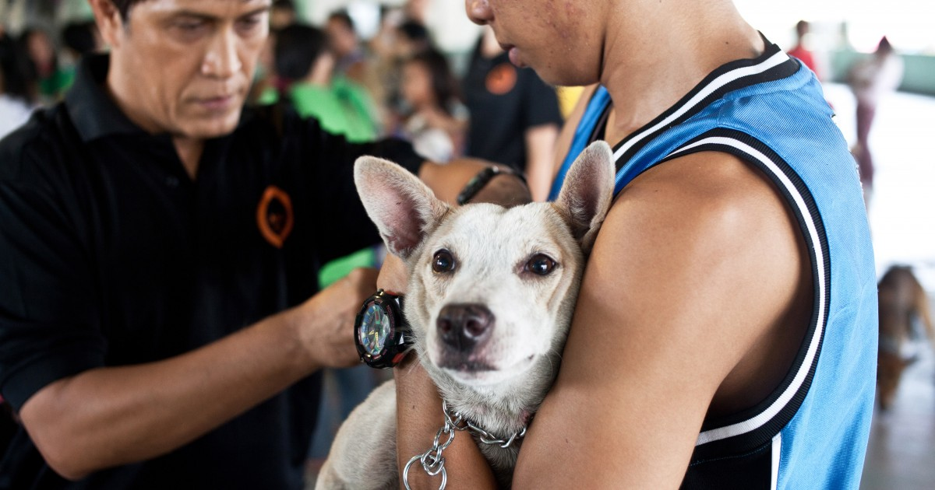
Questions Please :)
Thank you!

Slide 17

Long Demo - 4 minutes version

Slide 18
Why is our solution worth it?
Once the finders find the pet, they can receive the pet information through the QR code and contact the owner directly, which means that people don’t need to send pets to the shelters.
All the lost pets are shown on our website with the location showing on the map, which increase the possibility of them to be rescued.
The notification sent to the nearby user makes the reuniting process more efficient.
User-friendly and succinct web page design make it easier to use.
Real-time QR code information update through our web page

